Slide 1
HOTEL BOOKING OVERVIEW DASHBOARD
Created by Bhoomika Chourey

Slide 2
Introduction
This dashboard shows hotel booking data.
It helps to understand booking patterns.
It gives quick overview of performance.
Useful for decision making.

Slide 3
Objective of Dashboard
To track total bookings
To analyze booking status
To check advisor performance
To understand payment behavior

Slide 4
Dataset Details
Data includes hotel bookings
Columns used:
Booking ID
Advisor Email
Hotel ID
Booking Status
Payment Type
Data is used for analysis in Power BI

Slide 5
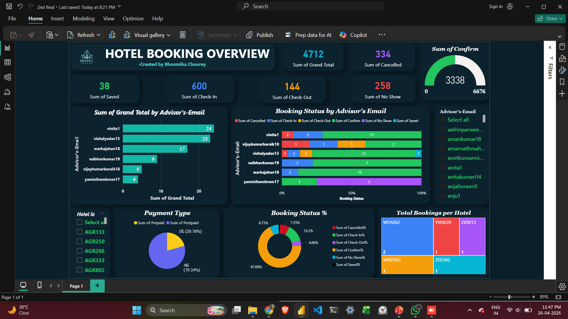

Slide 6

Key Metrics

Slide 7
Advisor Performance
Shows total bookings by each advisor
Helps identify top performers
Example:
vinita1 has average highest bookings
Useful for performance tracking

Slide 8

Booking Status Distribution
Shows booking types :
Cancelled Booking
Checked-In
Checked-Out
Confirmed Booking
No Show Booking
Helps understand booking behavior

Slide 9
Payment Analysis
Shows:
Prepaid
Postpaid
Majority bookings are Postpaid.
Useful for financial insights

Slide 10
Booking Status Percentage
Shows percentage of each booking type
Easy to compare data visually
Helps in quick understanding

Slide 11
Total Bookings per Hotel
Shows bookings by hotel ID
Helps identify:
High performing hotels
Low performing hotels

Slide 12
Filters Used
Advisor’s Email filter
Hotel’s ID filter
Helps user to:
View specific data
Customize dashboard

Slide 13
Key Insights
Most bookings are confirmed.
Some bookings are cancelled.
Few bookings are no-show.
Advisor’s performance varies.
Majority payments are not prepaid.

Slide 14
Conclusion
Dashboard gives clear overview.
Helps in quick decision making.
Improves performance tracking.
Useful for business analysis.

Slide 15
Thank You

